Slide 1
Auction management system
Teemu Erkkilä, Mikko Varis, Wissam Al-dabbagh
Group 10

Slide 2
Used Kimi K2 AI for frontend layout
Frontend GitHub https://github.com/ErkkilaT/Ohjelmistotuotantoprojekti/
Backend GitHub https://github.com/NullByte3/AuctionBackend
Trello link https://trello.com/w/usertyotila67260593

Slide 3
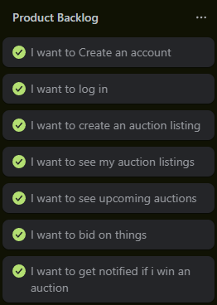
Product Backlog

Slide 4
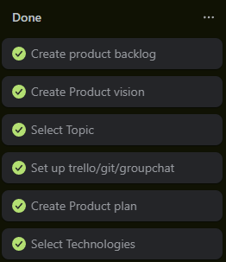

Sprint 1
Sprint Master: Teemu Erkkilä

Slide 5
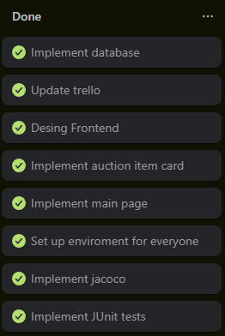
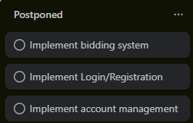
Sprint 2
Sprint Master: Mikko Varis

Slide 6
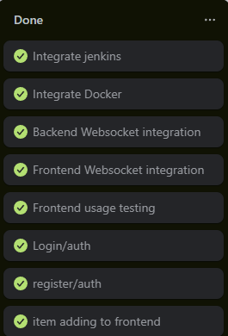

Sprint 3
Sprint Master: Wissam Al-dabbagh

Slide 7
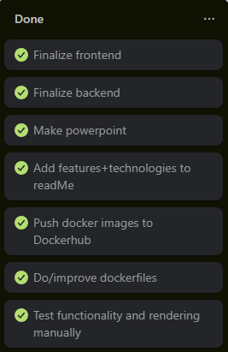
Sprint 4
Sprint Master: Teemu Erkkilä

Slide 8
Architectural Design (If Applied)
ER
Use case
Sequence Diagram
Activiti diagram
Class diagram

Slide 9
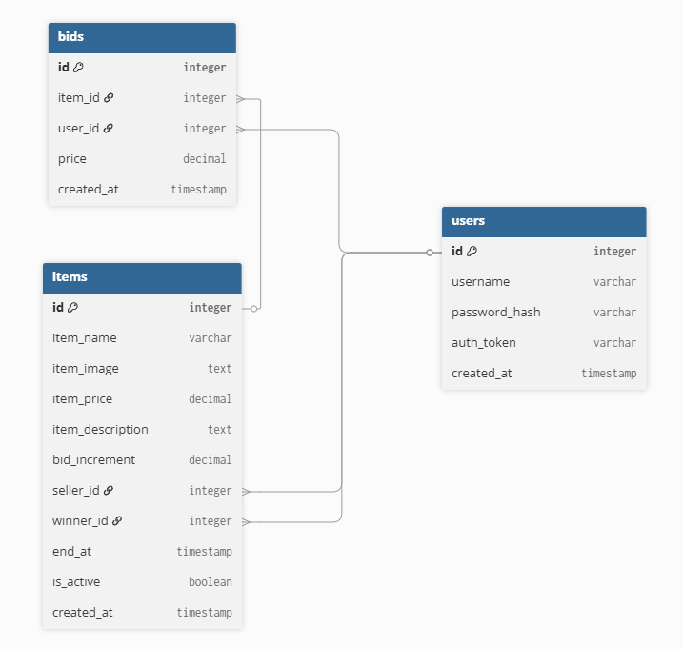
Database Schema Diagram

Slide 10
Applied Technologies

Slide 11
Demo
5 minutes maximum
Prototype demo

Slide 12
Learning achievement

Slide 13
Plan for further development
Feedback to the course:
https://ojp.metropolia.fi/lomakkeet/1/lomake.html?code=VFgwMEVZMjctMzAwNg==
https://ojp.metropolia.fi/lomakkeet/1/lomake.html?code=VFgwMEVZMjctMzAwMw==

